Slide 1

COURSE REGISTRATION SYSTEM
JEDI GROUP-6

Slide 2
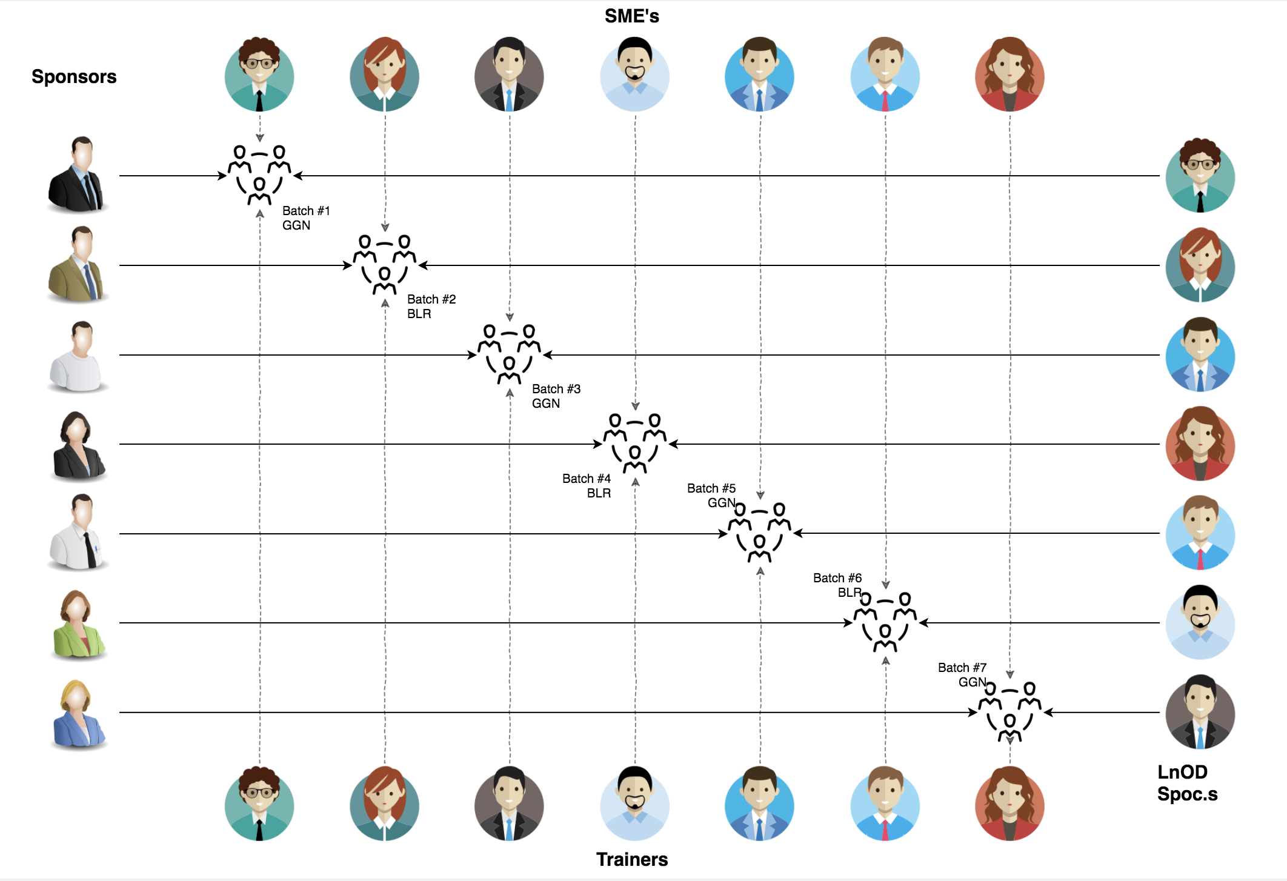
Stakeholders
Sponsors
Flipkart
SME’s
Amit Balyan
Course - Coordinators
Shree
Deepika
Neha

Slide 3
Framework for 2 Weeks
Regular training sessions to learn new technologies.
Daily quizzes to enhance the topic knowledge.
Intra group hangout meets to complete the assigned assignments.
Pushed to GitHub the working branches.
Technologies learnt - Github, UML, Linux, Java, MySQL, Jersey, Postman, Dropwizard

Slide 4
Our next starts
NOW
Notes:
Time – 1 min
Swati

Slide 5
2 WEEKS OF TRAINING + PROJECT DEMO
11 DAYS
165 HOURS
9900 MINUTES
594000 SECONDS
LIMITLESS KNOWLEDGE

Slide 6

Agenda
01
Our Journey
02
Our Team
03
Team Structure
04
Project Goals
05
Engineering Practices
06
Tech Stack
07
Development
08
Challenges & Learnings
09
Demo
10
Questions
Notes:
Time – 1 min

Slide 7

Our Journey
Notes:
Time - 2 mins

Slide 8
Demo
Implementation
Process
5
Project Demo
Tools
4
Coding/Testing
Comprehend
3
Decide the Technologies JAVA/REST
2
Design Thinking
1
Understanding Project Goals

Slide 9

Our Team
Notes:
Time – 2 mins

Slide 10
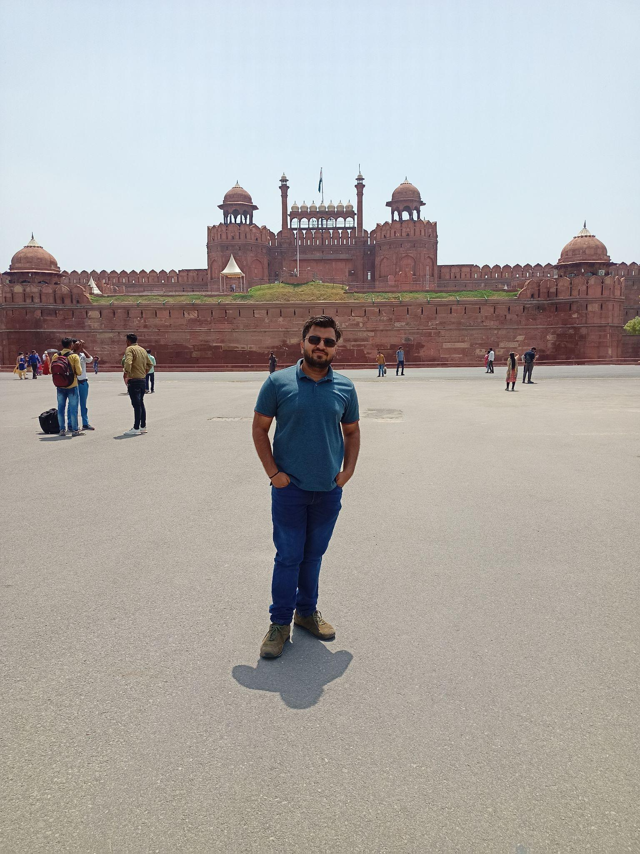


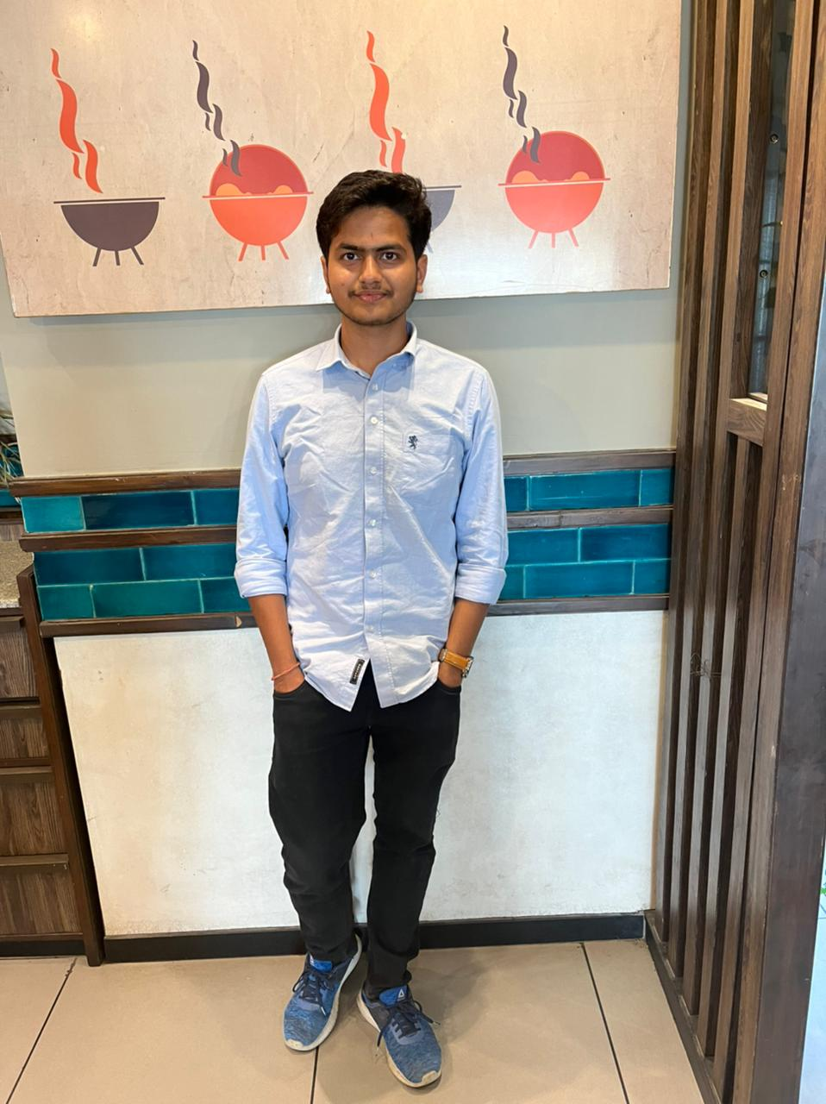

Harshit Singla
Sparsh Batra
Rajat Garg
Piyush Soni
Vanshika Yadav

Slide 11

Project Statement
Notes:
Time – 3 mins

Slide 12
To develop a course registration system for a universities which can be accessed by students, professors and Admins of the system.
These are the different features offered to different types of user:
Notes:
User satisfaction and brand value

Slide 13
CRS
STUDENT
PROFESSOR
ADMIN
Grade students enrolled in their courses
Manage users
Register
Apply for courses
Generate report cards
Choose the subjects to teach
Get grades
Approve students
Fee payment
Manage courses
Notes:
User satisfaction and brand value

Slide 14

Engineering Practices
Notes:
Time – 5 mins

Slide 15
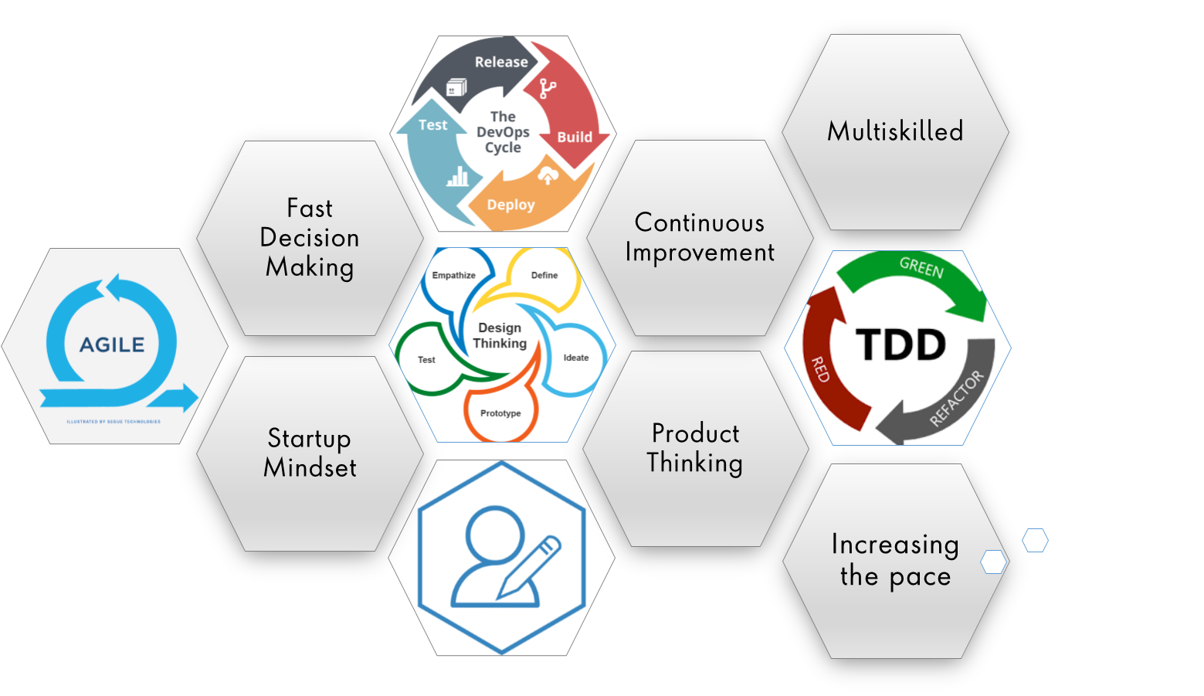
Notes:
Product Thinking (Design Thinking, Requirement Analysis, )
Multi Skilled (Frontend, Backend, DevOps)
Fast Decision Making (Agile)
Increasing the Pace (Automation CI/CD)
Startup Mindset (Agile)
Continuous Improvement (Retros)

Slide 16
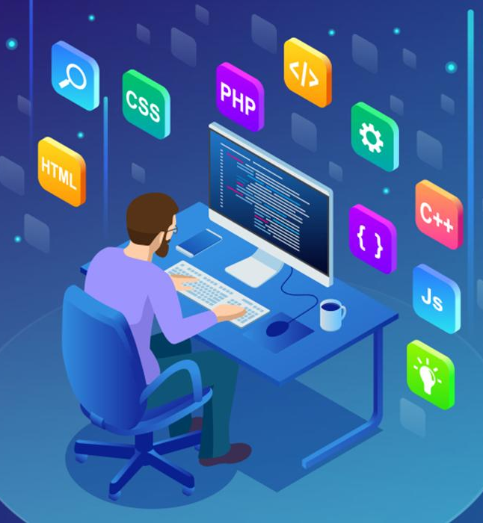
Tech Stack
Notes:
Time – 2 mins

Slide 17









Notes:
Time – 1 min

Slide 18

Development
Notes:
Time – 1 min

Slide 19
Requirement understanding
Research and analysis
Estimation
Feasibility test
Estimation
Sprint Planning
Spring Grooming
Sprint Implementation
Delivery
LLD
Development
Code Review
Commit
Integrate
Deploy
Test
Notes:
Time – 1 min

Slide 20

Challenges & Learnings
Notes:
Time – 2 mins

Slide 21
Learnings
Familiarization with Unix Commands.
Getting hang of the basic Git commands.
Software Development Life Cycle.
Knowledge and Implementation of Activity, Sequence and Use Case Diagram.
Java 8 features.
Integration of REST Services with Java code using Tomcat and Jersey.
Dropwizard Integration and Advantages.
Usage of Postman for testing APIs.
Javadoc Generation & basic Application Monitoring.

Slide 22
Challenges
Understanding the problem statement and initial implementation using Use Case, activity, sequence and class diagram.
Installing software on multiple environments.
Git merge conflicts.
Resolving jar and version dependencies.
Migration of project from one tech stack to another.
Database integration challenges.
Working Remotely.
Notes:
Time – 2 mins

Slide 23

Demo
Notes:
Time –
Architecture – 5 mins
NFR Dashboard – 3 mins
Demo – 10 mins
1. Show the Responsiveness and Wave tool first

Slide 24
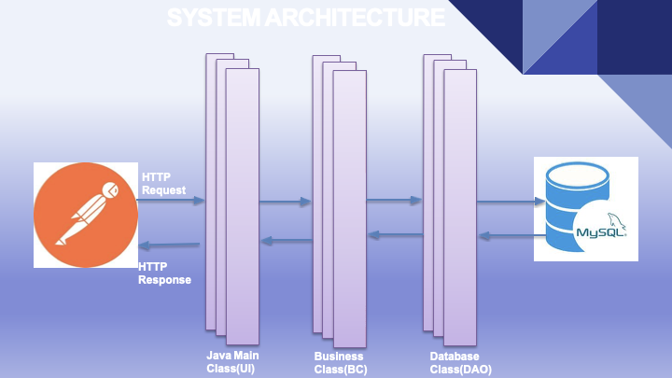

Slide 25
Thank you
Notes:
Time – After this show the testimonial video. 1 min

